Slide 1


University of Basrah College of Nursing
Management &Leadership in Nursing
Communication
Lecture four
Prepared by :- assist lect. Noor salah shreaf

Slide 2
Communication
Communication is an essential tool for nursing practice because a critical link exists between effective communication and positive patient outcomes.
Nurses must communicate effectively with all members of the health-care team, including other nurses, the patient, and the patient‘s family.
Effective communication involves two distinct steps: first, adequately articulating ideas; and second, understanding the listening audience with whom one is communicating

Slide 3
The Communication Process
The communication process includes the following elements :
Sender: The person who begins the transfer of information, thoughts, or ideas, and engages one or more other persons
Encoding: The process the sender uses to transmit the message, including verbal language, voice inflection, and body language.
Message: The information or content the sender is transferring, which can be transmitted verbally, nonverbally, and in writing
Sensory channel: The manner in which the message is sent, including visual (e.g., facial expressions, posture, and body language), auditory (e.g., spoken word), kinesthetic (e.g., touching and nonverbal communication), and electronic (e.g., media such as e-mail or text message)

Slide 4
Receiver: The person or persons whom the sender intended to receive the message
Decoding: The process of interpreting the message
Feedback: Determines whether the message was received as intended; can be verbal and nonverbal and allows the sender to correct or clarify the message sent and verify the message was received accurately

Slide 5
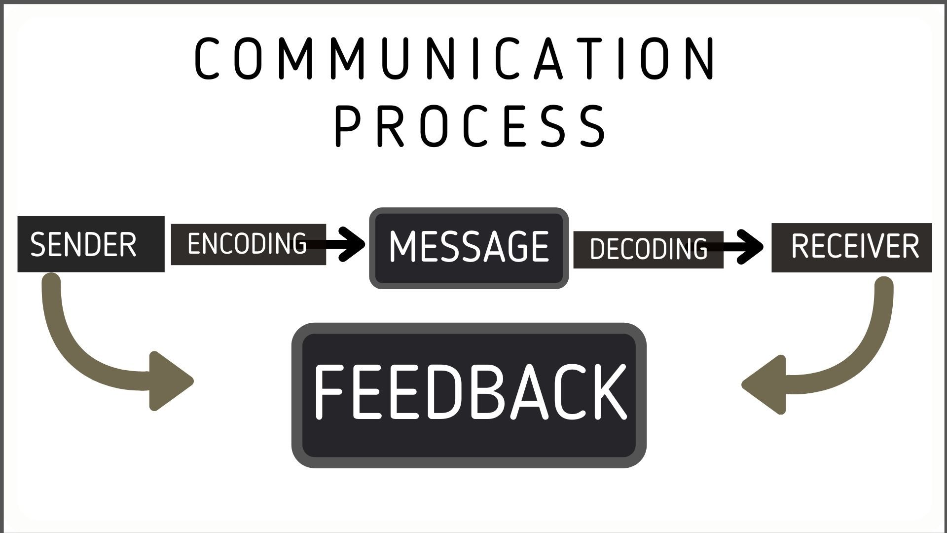

Slide 6
Verbal and Nonverbal Communication
Verbal Communication
Verbal communication is a conscious method of communication. It occurs face to face, by telephone, and through written messages such as e-mails.
Effective communication, whether spoken or written, is essential for nurses
when dealing with patients, especially when documenting nursing care and
pro- viding discharge instructions for patients and families. Precise
documentation of nursing care is vital because it is used by other nurses and
health-care professionals and in administrative records across an
Organization.

Slide 7
Nonverbal Communication
Even in moments of silence, communication continues. Nonverbal
communication encompasses behaviors, actions, and facial expressions that transmit messages in lieu of or in addition to verbal communication.
Nonverbal communication plays a central role in human interactions and is crucial in transmitting emotional and relational information.

Slide 8
Nonverbal communication can be conscious as well as subconscious and includes eye contact, facial expressions, gestures, posture, body movement, touch, and physical appearance. Facial behavior and expressions in particular (e.g., eye contact or lack of, smiling or grimacing) provide valuable clues and can indicate a person‘s comfort level with the topic under discussion.

Slide 9
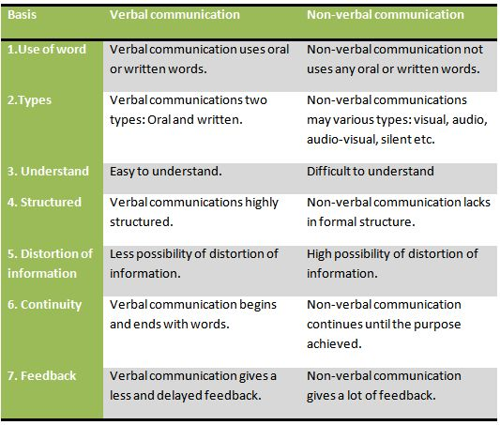

Slide 10
Active Listening
Effective communication requires the ability to listen actively .Hearing and listening are two different things: Hearing is the physiological
process of sound communicating with the hearing apparatus, whereas
listening is more active and participatory and requires energy and a high level of concentration.

Slide 11
Active listening is broken down into five stages;-
1. Receiving: Ensuring the nurse is in a good position to hear information
clearly
2. Attending: Engaging in the conversation by adopting positive body
language, facial expressions, and gestures
3. Understanding: Gaining an understanding of what is being said and what
may not be said
4. Responding: Responding to the patient in a nonjudgmental manner and
being aware if anything may have upset him or her
5. Remembering: Recalling previous conversations with the patient to establish a starting point when re-engaging Active listening also requires the nurse to put aside judgment, evaluation, and approval in a concerted effort to be aware of the emotions and attitudes of others.

Slide 12
FORMAL AND INFORMAL COMMUNICATION
Formal communication is described as ―a type of verbal presentation or document intended to share information and which conforms
to established professional rules, standards and processes and avoids using slang terminology.
Examples of formal communication that nurse leaders and managers may use include interviewing, counseling, dealing with complaints, managing conflict, evaluating, and disciplining.

Slide 13
During the formal communication process, it is critical for nurse leaders and managers to maintain professionalism and be effective communicators by:
● Using plain, direct language and avoiding jargon
● Using familiar illustrations to get points across
● Listening objectively
● Keeping questions short
● Giving clear, concise direction or instructions

Slide 14
Informal communication is a ―casual form of information sharing typically used in personal conversations with friends or family members.
Nurse leaders and managers may use informal communication when conversing with patients about personal business, such as children or pets. Informal communication is used for nurse managers and leaders to establish open lines of communication with staff and to create a culture in the workplace that allows employees to feel connected with each other

Slide 15
TYPES OF COMMUNICATION IN A HEALTH-CARE ENVIRONMENT
1- Organizational Communication:-
Health-care systems must communicate important information, such as regulations, policies, and procedures.
The goal of organizational communication is to convey the same message across the entire system. The ease with which communication flows through an organization has a great impact on the individual employee because it sets the tone for the climate of the working environment .

Slide 16
Various directions of communication may be used at the organizational
level.
Downward communication reflects the hierarchical nature of the
organization (e.g., the sending of information by administrators to nurse
leaders and managers or by nurse leaders and managers to staff).
Downward communication includes directives to employees, expectations
for employees, and performance feedback.

Slide 17
Lateral communication is the sharing of information among nurse leaders and managers or other staff at the same level. Examples of lateral communication are coordination between units and services, information sharing, problem solving, and conflict management.
diagonal communication This occurs , for example, when a nurse leader and manager communicates with the chief financial officer or the medical director.
upward communication is the sending of information up the hierarchal chain (e.g., staff to the nurse manager or leader, or nurse leader and manager to higher- level managers and administrators).

Slide 18
2- interprofessional communication fosters patient-centered care and results in quality outcomes. To communicate inter- professionally, nurse leaders and managers must communicate with all members of the health-care team, as well as with patients and their families.
In fact, evidence suggests that poor inter- professional communication impacts patient safety and quality of care globally.
Specifically, miscommunication between nurses and physicians contributes to medication errors, patient injuries, and patient deaths

Slide 19
REFERENCES
Koontz H &Weihrich H . Essentials of management an international
perspective. (Istedn). New Delhi: Tata McGraw Hill publishers; 2007.
Koontz H &Weihrich H. Management a global perspective. 1st edn. New Delhi: Tata Mc. Graw Hill publishers;2001.
Anthony M K, Theresa S, JoAnn Glick, Martha Duffy and Fran Paschall. Leadership and nurse retention, the pivotal role of nurse managers. JONA. Vol 35, Mar 2005.

Slide 20
Home work
TYPES OF COMMUNICATION IN A HEALTH-CARE ENVIRONMENT?
Different between FORMAL AND INFORMAL COMMUNICATION?
Communication Process?

Slide 21


